Slide 1
JDBC
by Tanmoy Barman
cont:- barmantanmoy.47@gmail.com

Slide 2
Discussions
What?
Architecture of JDBC.
Types of JDBC driver available.
Steps to connect to DB.
Types of Statement.
JDBC Data Source.

Slide 3
What is JDBC ?
JDBC acronym of java Database connectivity; though Sun Microsystems claims that it is not the full form.
JDBC is a standard java API for independent database connection between a java program and wide range of relational database.
It is present in the “java.sql” package

Slide 4
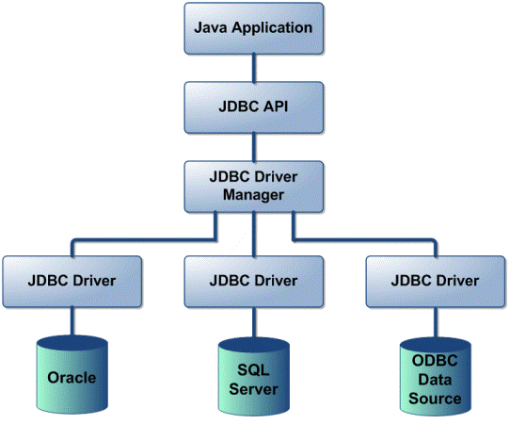
Architecture of JDBC

Slide 5
Types of JDBC driver
Type 1; jdbc-odbc bridge driver
Type 2; native API partly java driver.
Type 3; net protocols all java driver.
Type 4; native protocols all java driver.

Slide 6
Steps to connect?
Define the connection URL.
Established the connection.
Create the Statement object.
Execute a query.
Process the results.
Close the connection.

Slide 7
Steps to connect?
Define the connection url :
Class.forName();
For jdbc-odbc bridge driver:-
Class.forName(“sun.jdbc.odbc.JdbcOdbcDriver”);
For oracle driver:-
Class.forName(“oracle.jdbc.driver.OracleDriver”);
For My sql driver:-
Class.forName(“com.mysql.jdbc.Driver”);

Slide 8
Steps to connect?
Established the connection:
Connection con =DriverManager.getConnection(“url”,”user_name”,”pass”);

Slide 9
Steps to connect?
Create the Statement object:
Statement stmt=con.createStatement();

Slide 10
Steps to connect?
Execute the query:
For the SELECT query:-
    String sql=“SELECT * FROM EMP”;
    stmt.executeQuery(sql);
For the INSERT/UPDATE query:-
    String sql=“INSERT INTO EMP VALUES(47,’TEDDY’)”;
    stmt.executeUpdate(sql);

Slide 11
Steps to connect?
Process the result:-
ResultSet rs=stmt.execute Query(sql);
while(rs.next()){
System.out.println(rs.getInt(id));
System.out.print(rs.getString(name));
}

Slide 12
Steps to connect?
Close the connection
release all the resources that the connection is holding.
stmt.close();
con.close();

Slide 13
Steps to connect?
Summarizing the steps for connecting java DB and inserting values in DB, deployed on Net Beans IDE :-
Class.forName("org.apache.derby.jdbc.ClientDriver");
Connection con=DriverManager.getConnection("jdbc:derby://localhost:1527/orbacus","teddy","teddy");
Statement stmt=con.createStatement();
String sql=“INSERT INTO TEDDY(47,’jani’)”;
stmt.executeUpdate(sql);
stmt.close();
con.close();

Slide 14
Types of Statement available
There are three types of Statement available in Statement class:-
    Statement
    PreparedStatement
    CallableStatement

Slide 15
Types of Statement available
Statement
This represent a simple sql/mysql statement.
Statement stmt=con.createStatement();

Slide 16
Types of Statement available
PreparedStatement
this represent precompiled sql/my sql statement which allows improved performance. It allows to execute the query multiple times and we can set the values according to our need.
PreparedStatement psmt=con.prepareStatement();

Slide 17
Types of Statement available
CallableStatement
This allows the access of stored procedures; that are stored on the database.
CallableStatement csmt=con.prepareCall();

Slide 18
JDBC Data Source
The JDBC data source interface is an alternative to DriverManager class and conventional JBDC url. All the database information is present in the Naming service and retrieved using the JNDI API. The Data Source object contains the connection information which will make the actual connection and execute the JDBC commands.

Slide 19
JDBC Data Source:
Each Data Source is assigned a logical name by conventional beginning with jdbc/ .
Advantages:-
    Makes the code portable and reuse.
    The application does not have to remember the hardcore driver information.
    Connection pooling and distributed transaction advantages is facilitate.

Slide 20
JDBC Data Source:
Syntax:-
Context ctx=new InitialContext();
DataSource ds=(DataSource)ctx.lookup(“jdbc/teddyDB”);
Connection con=ds.getConnection(“user_name”,”pass”);

Slide 21
Thank You

